Slide 1
Introduction to Deep Learning
The slides are mostly adopted from material developed by:
Dr. Aiman El-Maleh, KFUPM, COE Department

Slide 2
Outline
Artificial Neural Networks
The Soft Perceptron
MLPs as Boolean Functions
MLPs as Universal Classifiers

Slide 3
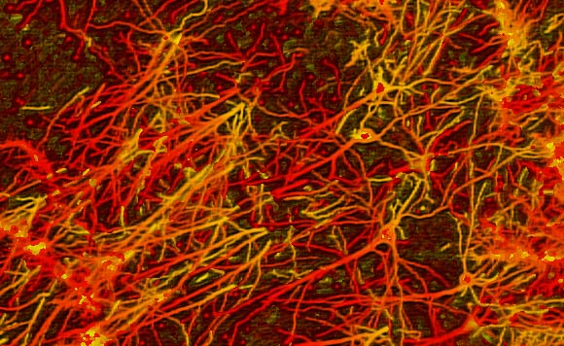
Neural Computation
Neural Computation is a general Machine Learning approach that involves processing information in a similar manner to the networks of neurons (i.e. Neural Networks) found in human/animal brains
Artificial Neural Networks (ANNs) are networks of Artificial Neurons, and hence constitute crude approximations to parts of real brains
They are massively parallel, which makes them efficient, robust, fault and noise tolerant

Slide 4
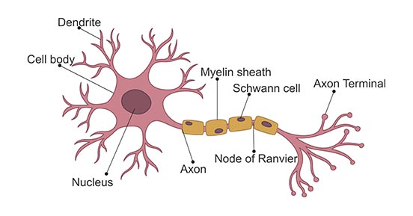
Artificial Neural Networks (ANNs)
A biological neuron highlights:
Signals come in through the dendrites into the Soma
A signal goes out via the axon to other neurons
Neurons are connected to and receive electrical signals from other neurons.
Neurons process input signals and can be activated.
Soma (Cell Body)
Single Neuron

Slide 5
Artificial Neural Networks (ANNs)
Mathematical model for learning inspired by biological neural networks.
Model mathematical function from inputs to outputs based on the structure and parameters of the network.
Allows for learning the network's parameters based on data.
Neural networks have become one of the major thrust areas recently in various AI tasks including pattern recognition, prediction, and analysis problems
In many problems they have established the state of the art, often exceeding previous benchmarks by large margins

Slide 6
Mathematically Modeling of a single neuron
We can model a single neuron mathematically loosely by using a perceptron as shown below:

Slide 7
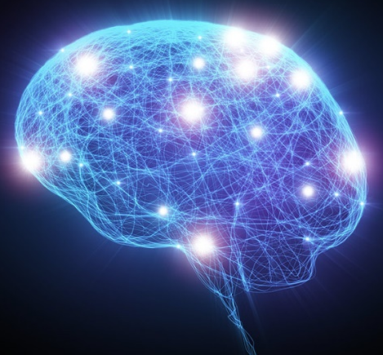
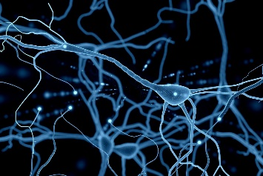
Artificial Neural Networks (ANNs)
Neural nets are composed of networks of neurons called perceptrons

Slide 8
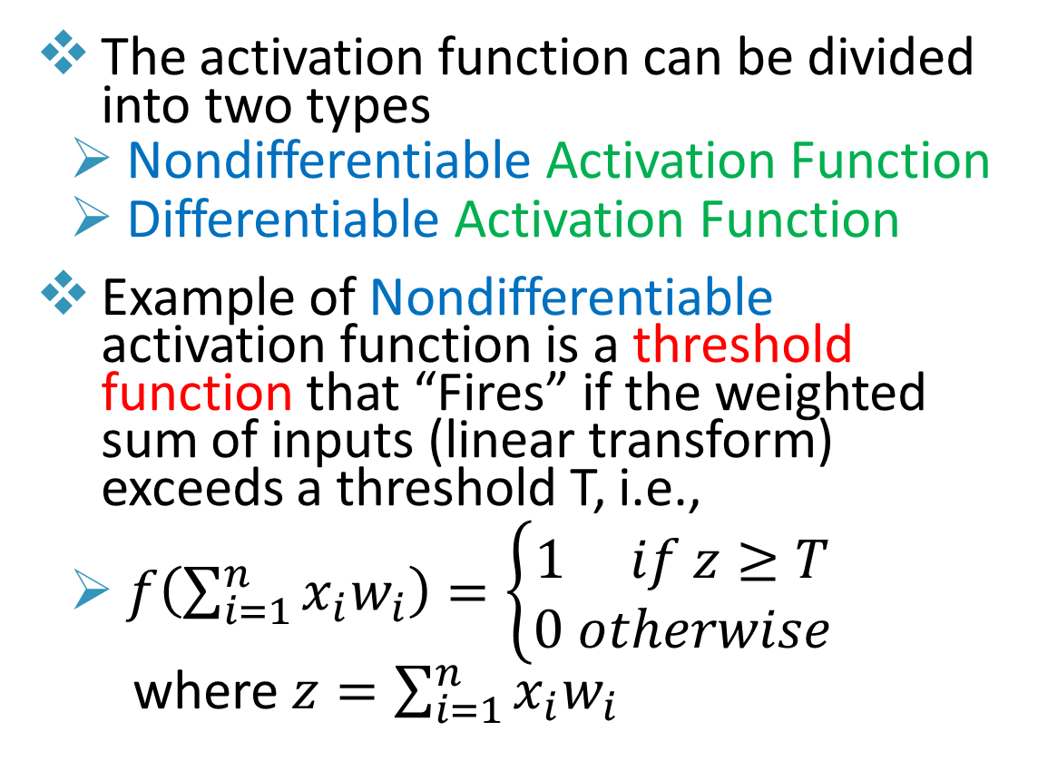
The Perceptron
The activation function can be divided into two types
Nondifferentiable Activation Function
Differentiable Activation Function
Example of Nondifferentiable activation function is a threshold function that “Fires” if the weighted sum of inputs (linear transform) exceeds a threshold T, i.e.,
$f\left(\sum_{i=1}^{n}{x_{i}w_{i}}\right)=\left\{\begin{matrix}1 if z≥T \\ 0 otherwise\end{matrix}\right.$
where $z=\sum_{i=1}^{n}{x_{i}w_{i}}$

Slide 9
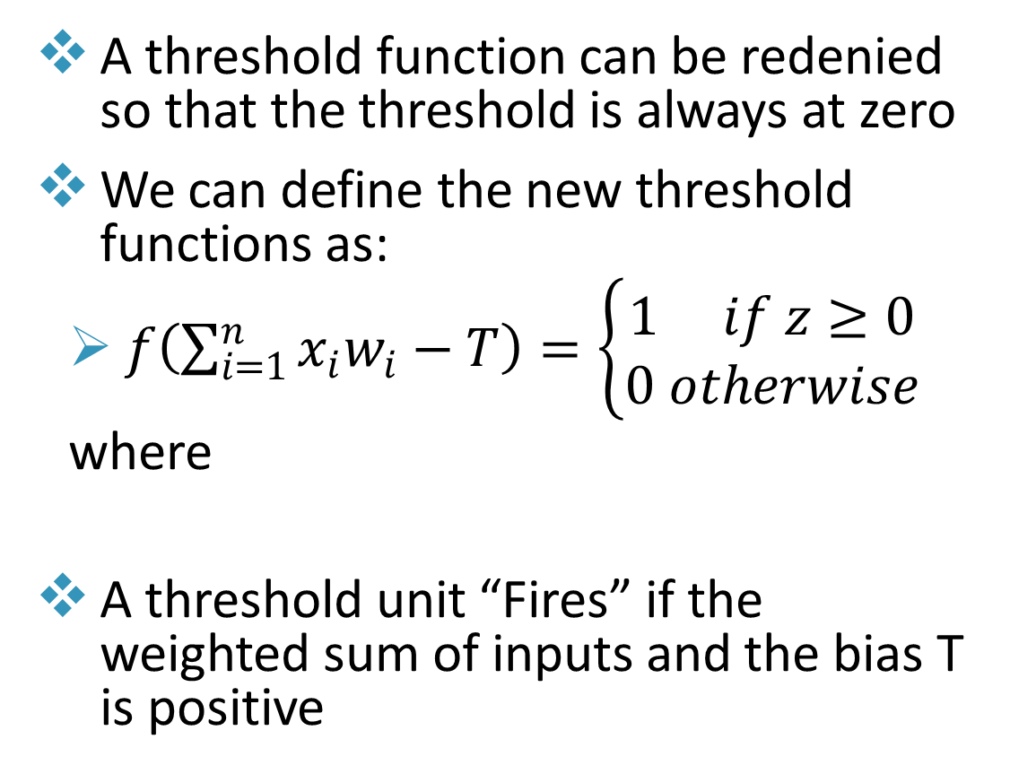

The Perceptron
A threshold function can be redenied so that the threshold is always at zero
We can define the new threshold functions as:
$f\left(\sum_{i=1}^{n}{x_{i}w_{i}−T}\right)=\left\{\begin{matrix}1 if z≥0 \\ 0 otherwise\end{matrix}\right.$
where
A threshold unit “Fires” if the weighted sum of inputs and the bias T is positive
$$z=\sum_{i=1}^{n}{x_{i}w_{i}}−T=\sum_{i=1}^{n}{x_{i}w_{i}}+b$$

Slide 10
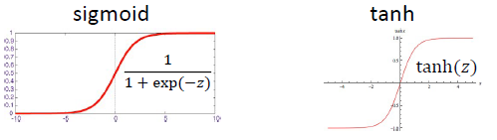
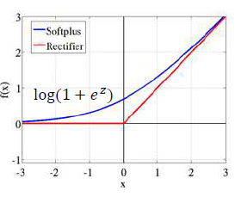
The “Soft” Perceptron
Differentiable Activation Functions are often non-linear
The Activation Function is used at the output which normalizes the output to a range of values and helps the network learn complex data
Examples of such functions are:
Sigmoid
Tanh
Softplus
Rectifier(Relu)
…

Slide 11
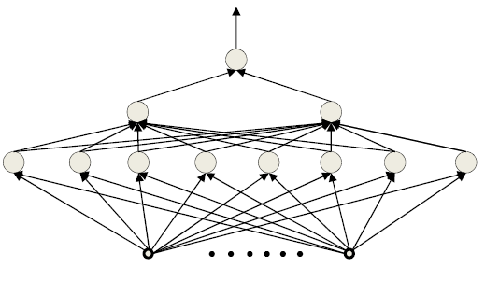
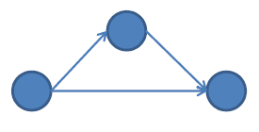
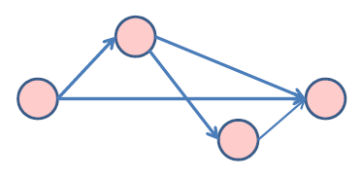
The Multi-Layer Perceptron (MLP)
A network of perceptrons is generally layered (layer 1 → layer 2 → layer 3, etc.)
“depth” in a network is the length of the longest path from a source to a sink
Inputs are real or Boolean stimuli
Outputs are real or Boolean values
Can have multiple outputs for a single input
“Deep” → Depth > 2
All middle layers are called hidden layers
Depth = 2
Depth = 3

Slide 12
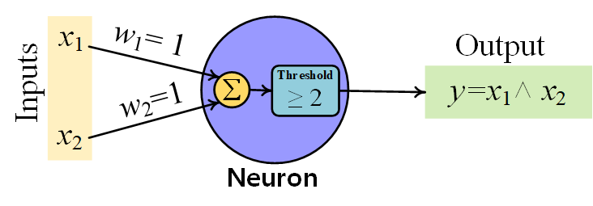
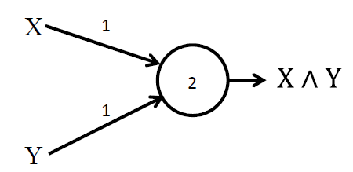
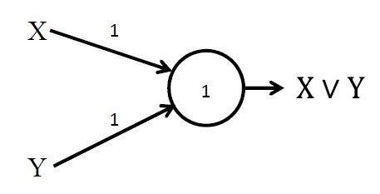
MLPs as Boolean Functions
The perceptron can mimic primitive Boolean gates
AND
OR
≡
≡

Slide 13
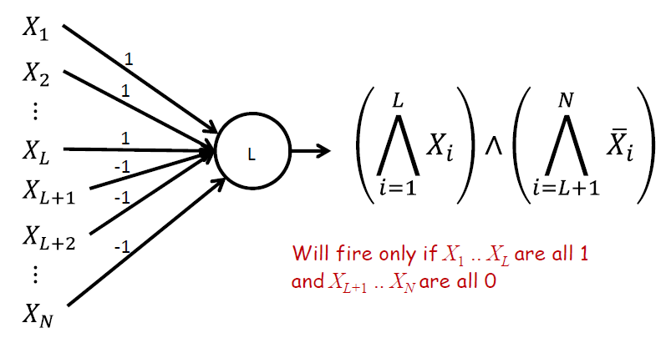
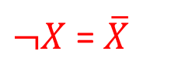
MLPs as Boolean Functions
MLPs can compute any Boolean function since they can emulate individual gates
X1
1
1
X2
2
-1
X3
Universal AND gate
$¬X$ = $\overline{X}$

Slide 14
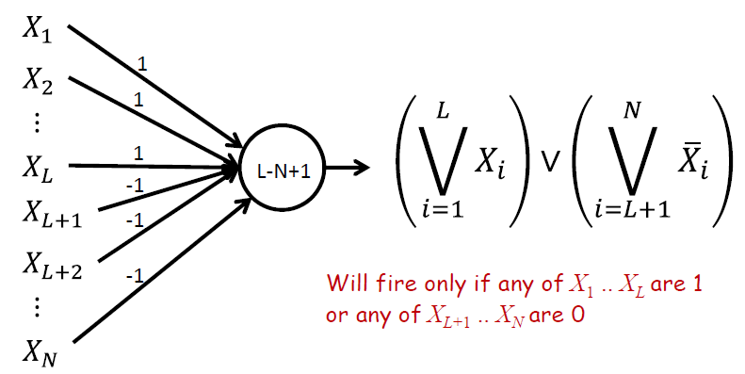
MLPs as Boolean Functions
MLPs can compute any Boolean function since they can emulate individual gates
X1
1
1
X2
0
-1
X3
2-3+1=0
$¬X$ = $\overline{X}$
Universal OR gate

Slide 15
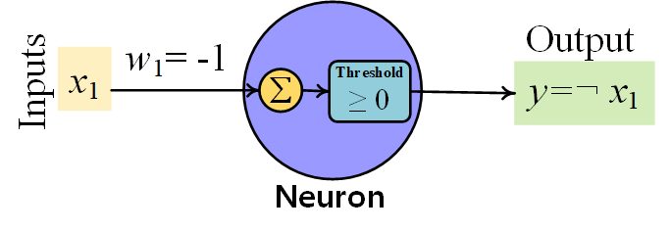
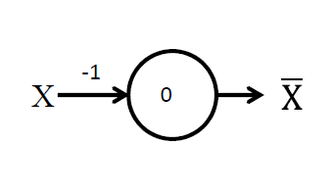
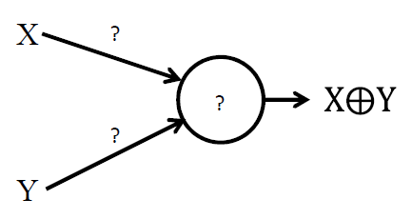
MLPs as Boolean Functions
The perceptron can mimic primitive Boolean gates
NOT
No solution for XOR gate using single perceptron!!
≡

Slide 16
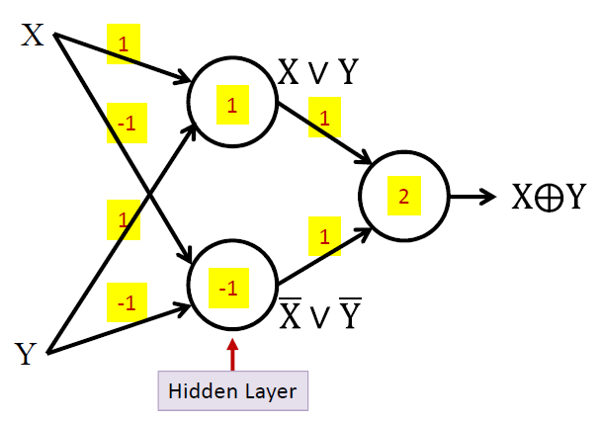
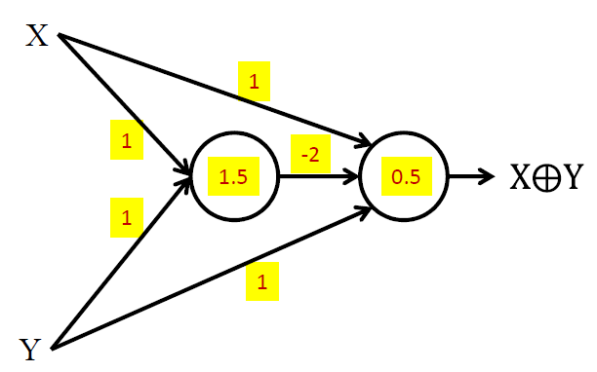
MLPs as Boolean Functions
XOR Function:
(XVY) ∧ (¬XV¬Y)
XOR gate

Slide 17
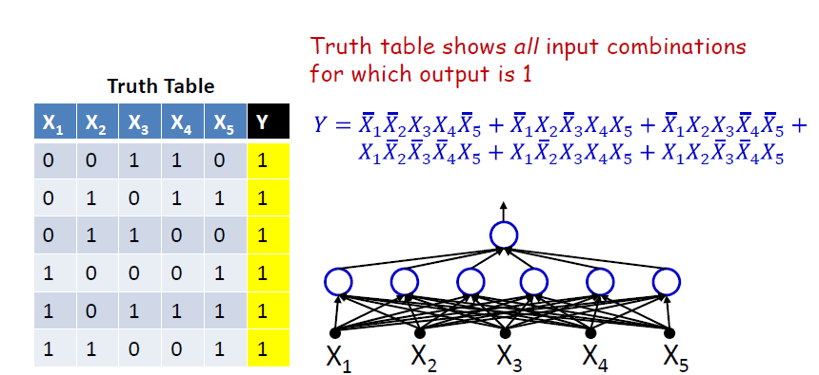
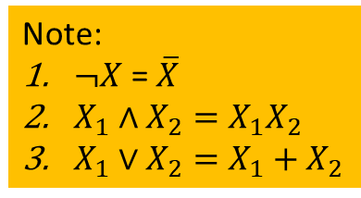
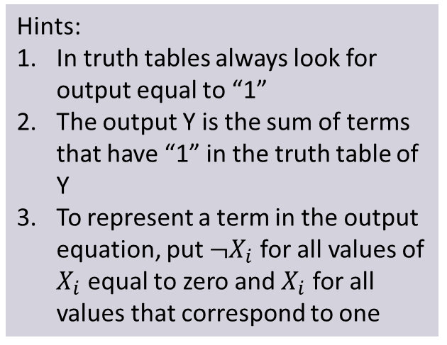
MLPs as Boolean Functions
A one-hidden-layer MLP is a Universal Boolean Function
It can represent any function by expressing it in terms of the input conditions that make the function true
Hints:
In truth tables always look for output equal to “1”
The output Y is the sum of terms that have “1” in the truth table of Y
To represent a term in the output equation, put $¬X_{i}$ for all values of $X_{i}$ equal to zero and $X_{i}$ for all values that correspond to one
Note:
$¬X$ = $\overline{X}$
$X_{1}∧X_{2}=X_{1}X_{2}$
$X_{1}∨X_{2}=X_{1}+X_{2}$

Slide 18
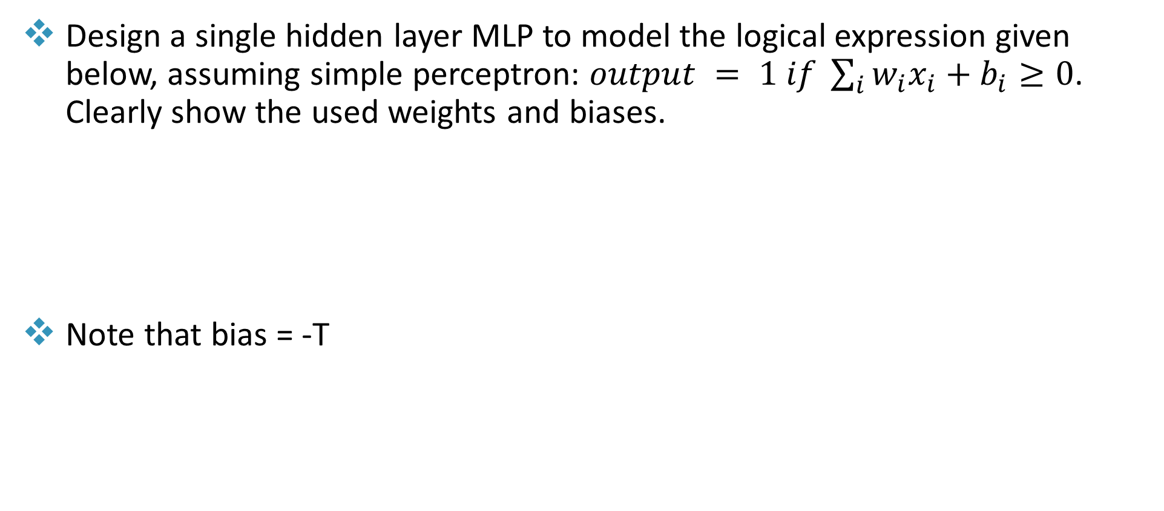
MLPs as Boolean Functions
Design a single hidden layer MLP to model the logical expression given below, assuming simple perceptron: $output = 1 if \sum_{i}{w_{i}x_{i}}+b_{i}≥0$. Clearly show the used weights and biases.
Note that bias = -T
Y = A ∧ B ∧ D V ¬C ∧ D

Slide 19
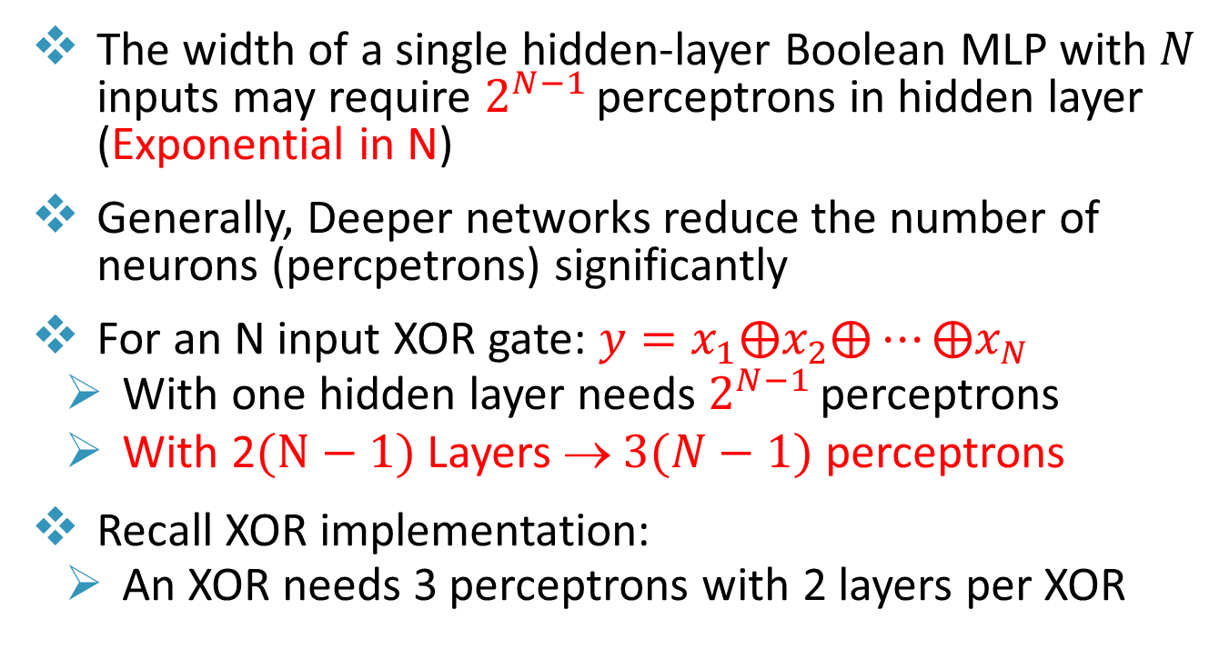
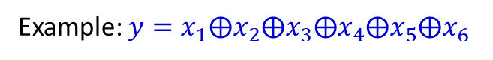
MLPs as Boolean Functions
The width of a single hidden-layer Boolean MLP with $N$ inputs may require $2^{N−1}$ perceptrons in hidden layer (Exponential in N)
Generally, Deeper networks reduce the number of neurons (percpetrons) significantly
For an N input XOR gate: $y=x_{1}⨁x_{2}⨁⋯⨁x_{N}$
With one hidden layer needs $2^{N−1}$ perceptrons
With 2$(N−1)$ Layers → $3(N−1)$ perceptrons
Recall XOR implementation:
An XOR needs 3 perceptrons with 2 layers per XOR
Example: $y=x_{1}⨁x_{2}⨁x_{3}⨁x_{4}⨁x_{5}⨁x_{6}$

Slide 20
MLPs as Boolean Functions
An MLP can represent a given function only if it is sufficiently wide and sufficiently deep
A network with fewer than the minimum required number of neurons cannot model the function
Optimal width and depth depend on the number of variables and the complexity of the Boolean function
Deeper networks may require far fewer neurons than shallower networks to express the same function
The actual number of parameters in a network is the number of connections
Networks that require an exponential number of neurons will require an exponential number of weights

Slide 21
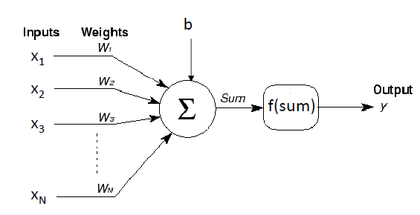
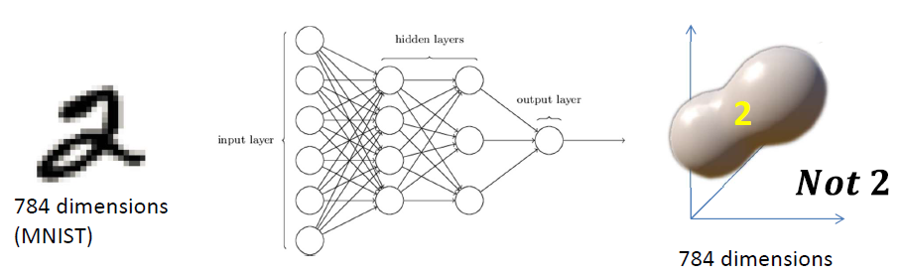
MLPs as Universal Classifiers
The “real” valued perceptron
Inputs and weights are real values
Output could be Boolean or real
Any real-valued “activation” function may operate on the weighted sum input
MLP as a function over real inputs finds a complex “decision boundary” over a space of reals
28x28 image

Slide 22
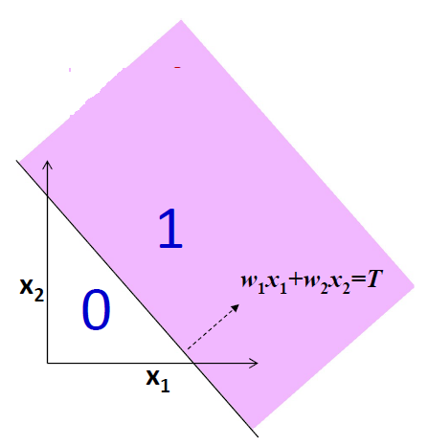
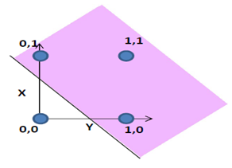
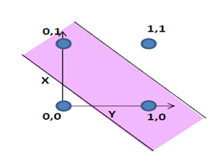
MLPs as Universal Classifiers
A perceptron operating on real-valued vectors is a linear classifier
Boolean perceptrons are also linear classifiers
If we have n inputs, the weights define a decision boundary that is an n–1 dimensional hyperplane
x2 = -w1/w2 x1 + T/w2
X OR Y
X XOR Y

Slide 23
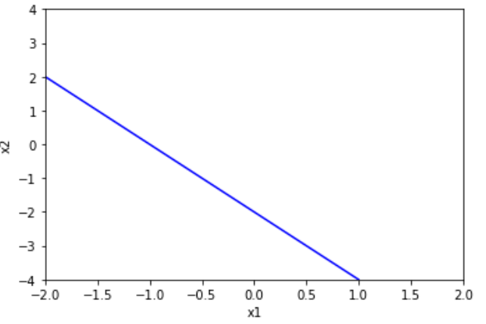
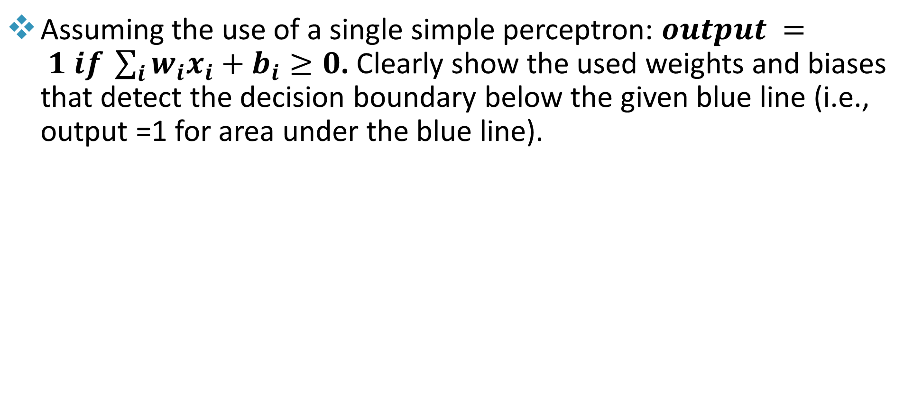
MLPs as Universal Classifiers
Assuming the use of a single simple perceptron: $output = 1 if \sum_{i}{w_{i}x_{i}}+b_{i}≥0$. Clearly show the used weights and biases that detect the decision boundary below the given blue line (i.e., output =1 for area under the blue line).
Equation of the line x2 = -2x1 -2
Thus, the decision boundary is x2<= -2x1 - 2
=> 0<= -2x1 -x2 -2
Thus, w1=-2, w2=-1, b=-2

Slide 24
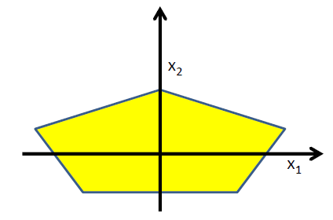
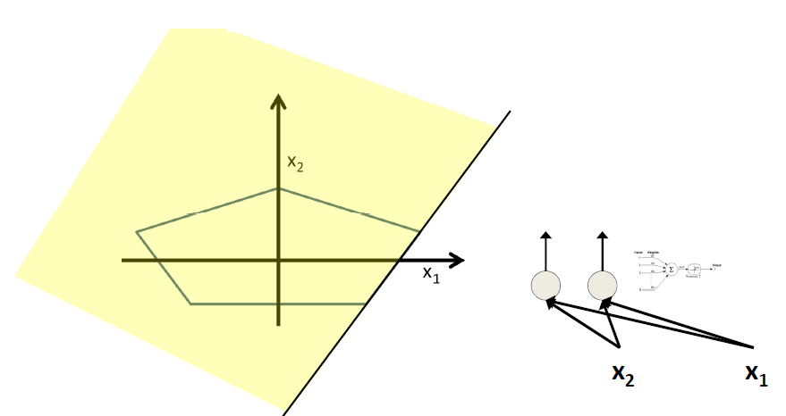
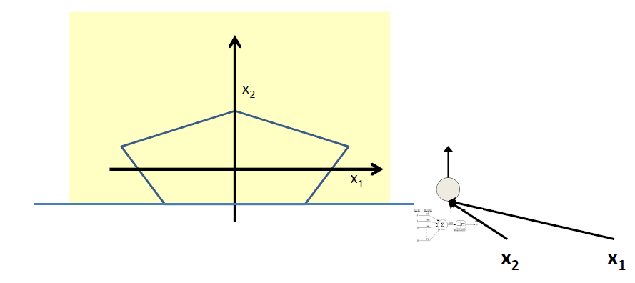
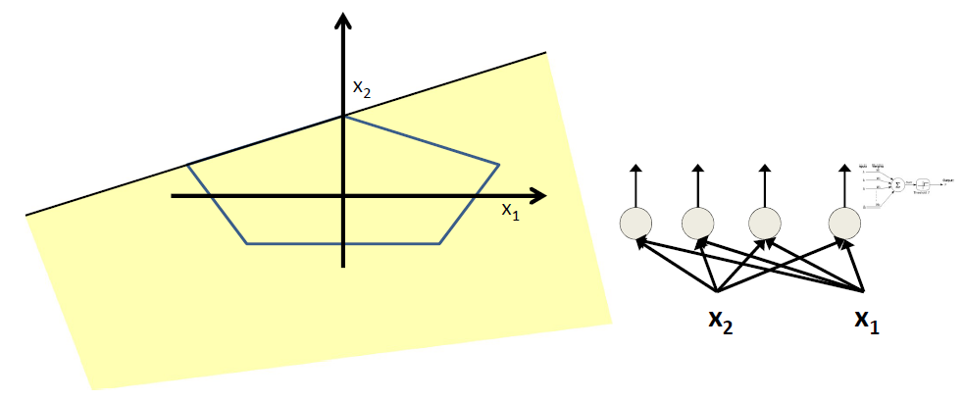
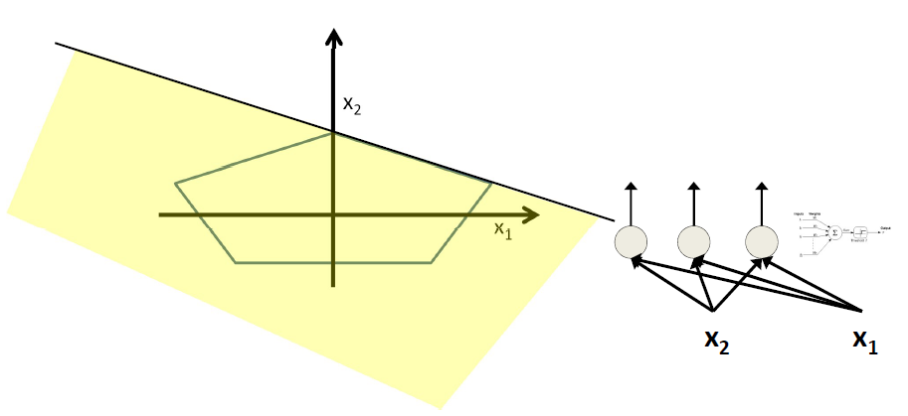
Composing Complex “Decision” Boundaries
Build a MLP network with a single output that fires if the input is in the colored area
The network must fire if the input is in the colored area

Slide 25
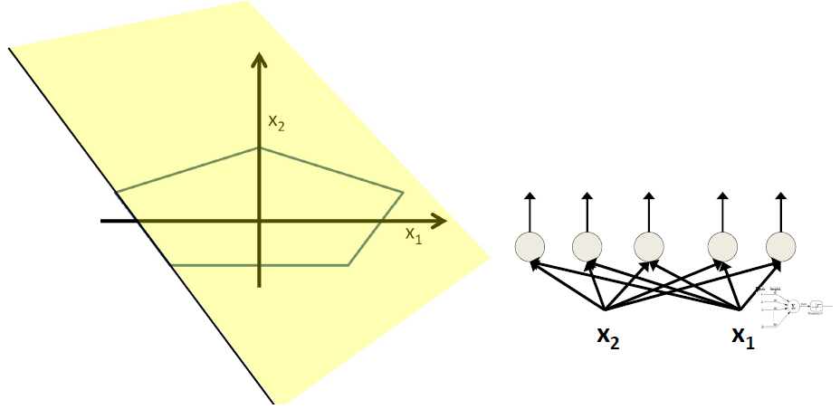
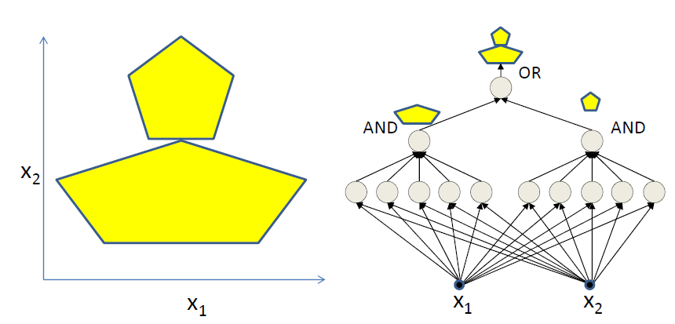
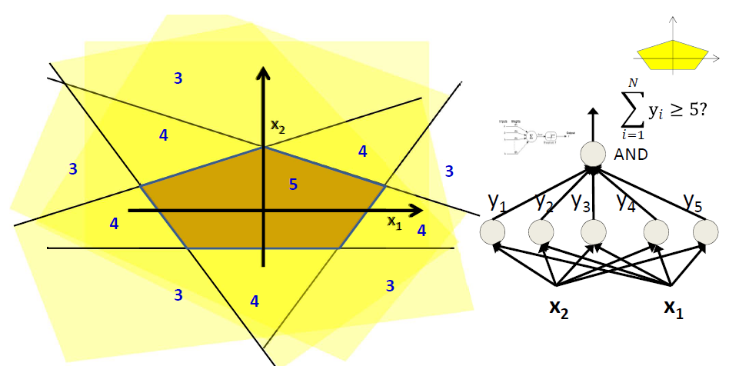
Composing Complex “Decision” Boundaries

Slide 26
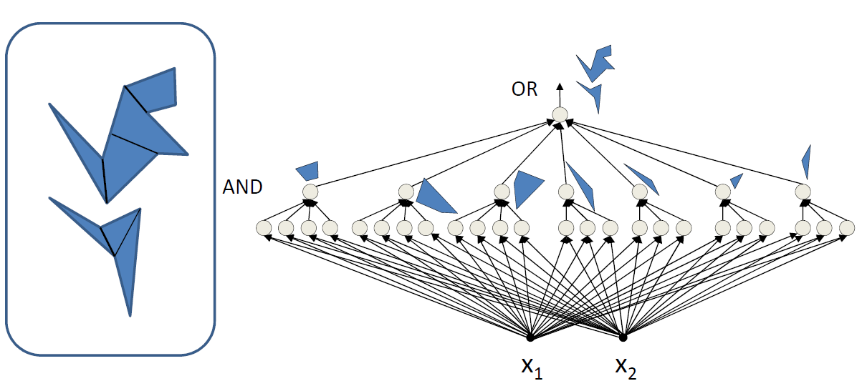
Composing Complex “Decision” Boundaries
MLPs can compose arbitrarily complex decision boundaries

Slide 27
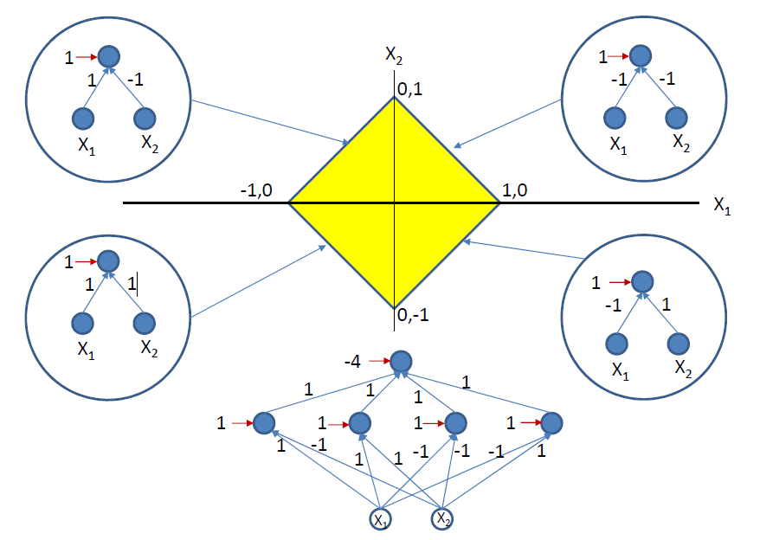
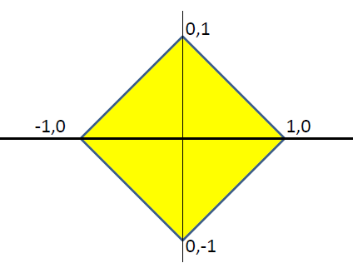
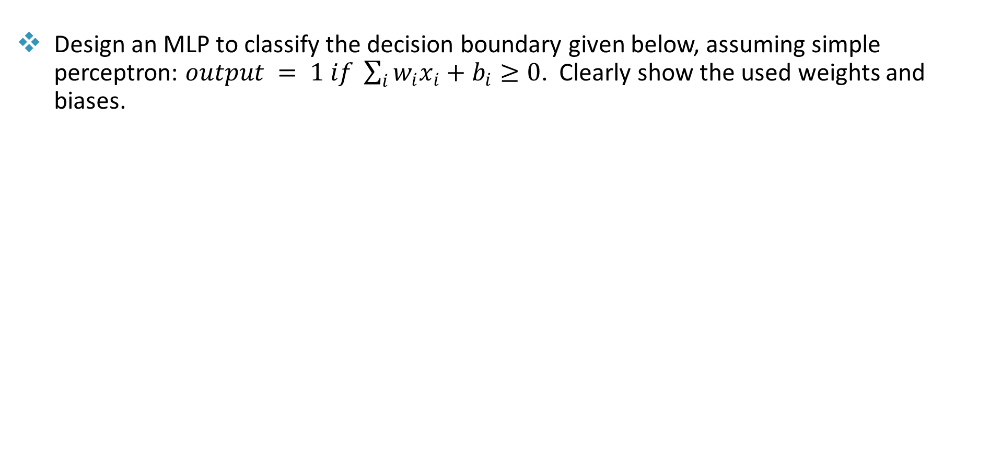
Composing Complex “Decision” Boundaries
Design an MLP to classify the decision boundary given below, assuming simple perceptron: $output = 1 if \sum_{i}{w_{i}x_{i}}+b_{i}≥0$. Clearly show the used weights and biases.

Slide 28
Introduction to Deep Neural Networks
Accomplishing tasks that require considerable effort from humans to accomplish are the target application of Deep Neural Networks.
These tasks are frequently so challenging that even humans must put forth a lot of effort over the course of a lifetime to master them.
Examples of these tasks are:
Speech Recognition
Atomic Language Translation
Computer Vision

Slide 29

Speech Recognition
Speech Recognition is the task of understanding the content of spoken language
Speech recognition includes:
Accurate understanding of the spoken content
Knowledge of the language spoken
Clear audition, i.e., correct inference of what was spoken
Good generalization skills to parse content in the face of tremendous variability in speakers
Speaking styles
Recognize the effect of infinite physical, physiological, emotional and other influences on the human voice.

Slide 30

Atomic Language Translation
After almost 40 years of research, in 2015 Machine Translation systems still performed very poorly.
How to test translation:
Translating a sentence in one language to some other language
Translating the result of the translation back to the original language
Compare the output with the meaning of the original text

Slide 31

Computer Vision
Computer Vision deals with how computers can gain high-level understanding from digital images or videos
Computer Vision requires:
Objects to be Detected and Classified
Isolated Objects (segmented)
Tagging of detected objects

Slide 32
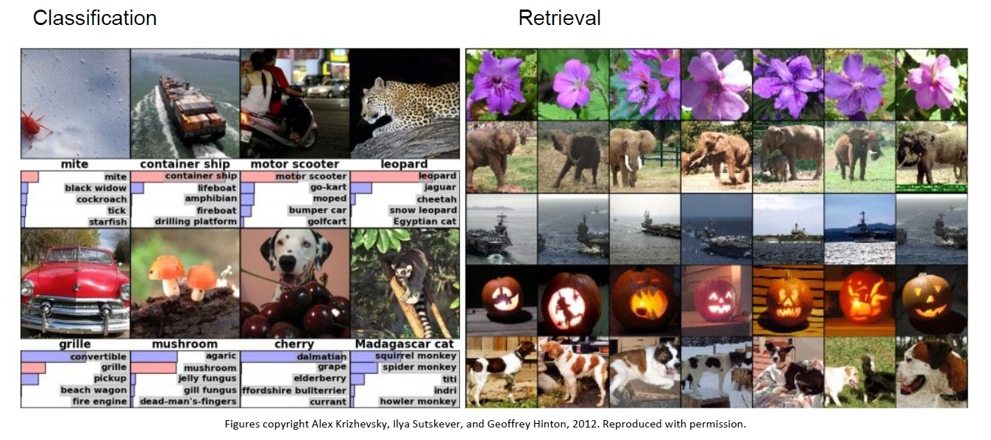
Applications of Deep Learning Networks

Slide 33
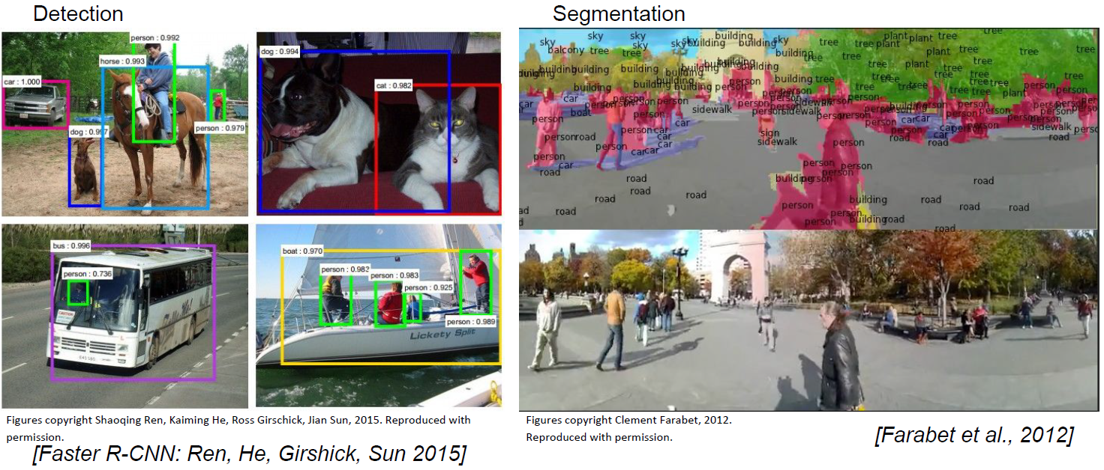
Applications of Deep Learning Networks

Slide 34
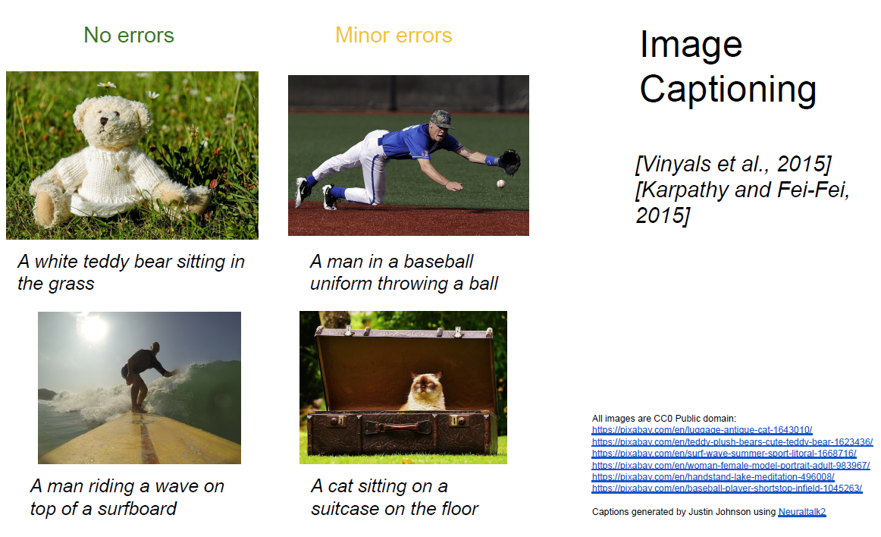
Applications of Deep Learning Networks

Slide 35
Acknowledgments
Slides have been used from:
https://www.cs.cmu.edu/~bhiksha/courses/deeplearning/Spring.2019/www/

